Slide 1
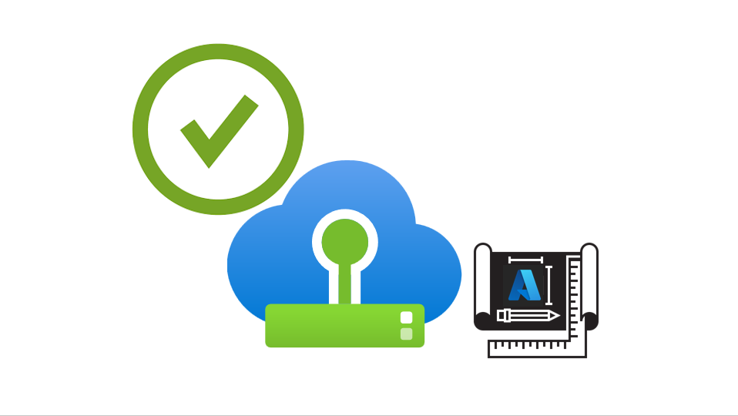
Azure VMware Solution Availability Design Template

Slide 2


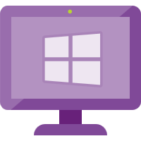
Users
Traffic Flow
Load Balancer Layer
LB 1
LB 2
Web Layer
Web 1
Web 2
Web 3
App Layer
App 1
App 2
App 3
Database Layer
DB 1
(R/W)
DB 2
(R)
DB 3
(R)
Figure 1 – Typical Legacy Business-Critical Application Architecture

Slide 3


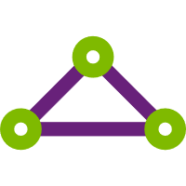







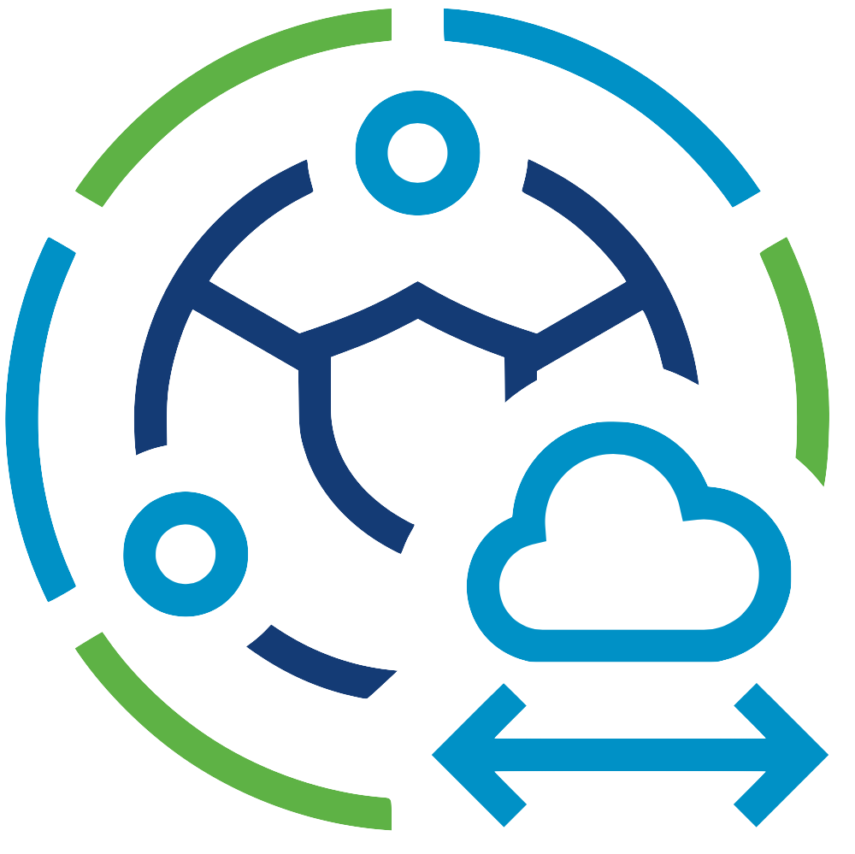


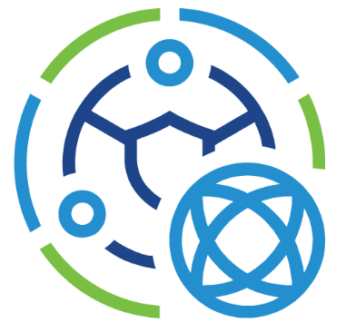

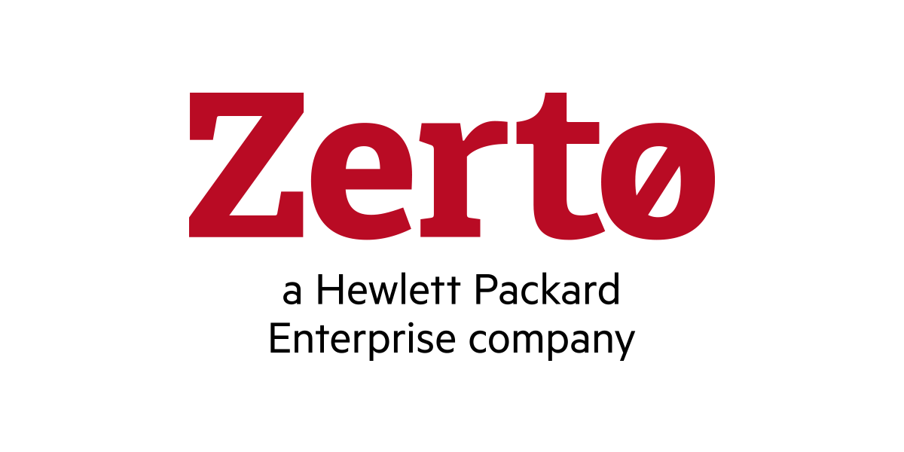
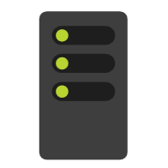



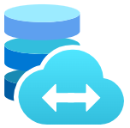
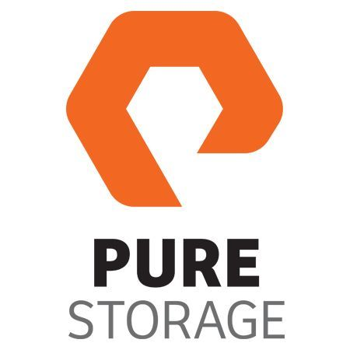
Microsoft Azure
Azure Subscription
Azure ExpressRoute
Dedicated Microsoft
Enterprise Edge
Azure Region
Azure Virtual Network
Azure Virtual WAN
Azure Resource Group
Azure Route Server
Azure Virtual Network
Gateway
Azure VMware Solution
Private Cloud
VMware HCX
VMware SRM
Azure VMware Solution
Resource Cluster
Zerto DR
VMware
vCenter Server
VMware NSX
JetStream
DR
Azure Bare-Metal
ESXi hosts
VMware
vSAN Datastore
Azure Bare-Metal
ESXi hosts
VMware
vSAN Datastore
Azure NetApp Files
Azure Elastic SAN
Pure Cloud Block Store
Figure 2 – Azure VMware Solution Architectural Components

Slide 4




Microsoft Azure
Single AZ in an Azure Region
Single Azure Subscription
Azure VMware Solution
Private Cloud
Cluster-1 (Management & Control Plane Cluster)
Azure Bare-Metal
ESXi hosts
VMware
vSAN Datastore
VMware
vCenter Server
VMware NSX
VMware NSX
Edges
VMware HCX
VMware SRM
Gold SLA Apps
Silver SLA Apps
Bronze SLA Apps
Enterprise
Services
Cluster-2 -> Cluster-12 (Resource Clusters)
Azure Bare-Metal
ESXi hosts
VMware
vSAN Datastores
Gold SLA Apps
Silver SLA Apps
Bronze SLA Apps
Figure 3 – Azure VMware Solution Private Cloud Standard Topology

Slide 5
Microsoft Azure
Single Azure Region
Azure Subscription A
Azure Subscription B
AZ1
AZ2
Azure VMware Solution
Private Cloud A
Azure VMware Solution
Private Cloud B
Azure Bare-Metal
ESXi hosts
VMware
vSAN Datastore
VMware
vCenter Server
VMware NSX
Azure Bare-Metal
ESXi hosts
VMware
vSAN Datastore
VMware
vCenter Server
VMware NSX
VMware NSX
Edges
VMware HCX
VMware SRM
Gold SLA Apps
A-Side
VMware NSX
Edges
VMware HCX
VMware SRM
Gold SLA Apps
B-Side
Application Clustering
Mobility & Layer 2 Network Extension
Figure 4 – Azure VMware Solution Private Cloud Multi-AZ Topology

Slide 6
Microsoft Azure
Dual AZs in an Azure Region
Single Azure Subscription
AZ1 – Preferred Site
AZ2 – Secondary Site
Azure VMware Solution
Private Cloud A
Stretched vSAN Datastore
Azure Bare-Metal
ESXi hosts
VMware
vSAN Datastore
Preferred
Fault Domain
VMware
vCenter Server
VMware NSX
Azure Bare-Metal
ESXi hosts
VMware
vSAN Datastore
Secondary
Fault Domain
VMware NSX
Edge A
VMware HCX
Gold SLA Apps
VMware NSX
Edge B
Gold SLA Apps
Silver SLA Apps
Bronze SLA Apps
Policy-based Synchronous Replication
AZ3 – Witness Site
VMware vSAN
Witness Appliance
Figure 5 – Azure VMware Solution Private Cloud with Stretched Clusters Topology

Slide 7
Microsoft Azure
Single Azure Subscription
Single AZ in an Azure Region A
Single AZ in an Azure Region B
Azure VMware Solution
Private Cloud A
Azure VMware Solution
Private Cloud B
Azure Bare-Metal
ESXi hosts
VMware
vSAN Datastore
VMware
vCenter Server
VMware NSX
Azure Bare-Metal
ESXi hosts
VMware
vSAN Datastore
VMware
vCenter Server
VMware NSX
VMware NSX
Edges
VMware HCX
VMware SRM
Gold SLA Apps
A-Side
VMware NSX
Edges
VMware HCX
VMware SRM
Gold SLA Apps
B-Side
Application Clustering
Mobility & Layer 2 Network Extension
Figure 6 – Azure VMware Solution Private Cloud Multi-Region Topology

Slide 8
Microsoft Azure
Azure VMware Solution
Private Cloud
Cluster-1 (Management & Control Plane Cluster)
Azure Bare-Metal
ESXi hosts
VMware
vSAN Datastore
VMware
vCenter Server
VMware NSX
VMware NSX
Edges
VMware HCX
VMware SRM
Gold SLA Apps
Silver SLA Apps
Bronze SLA Apps
Enterprise
Services
Figure 7 – Azure VMware Solution Shared Services Model

Slide 9
Microsoft Azure
Azure VMware Solution
Private Cloud
Cluster-1 (Management & Control Plane Cluster)
Azure Bare-Metal
ESXi hosts
VMware
vSAN Datastore
VMware
vCenter Server
VMware NSX
VMware NSX
Edges
VMware HCX
VMware SRM
Enterprise
Services
Cluster-2 (Gold Resource Cluster)
Cluster-3 (Silver Resource Cluster)
Azure Bare-Metal
ESXi hosts
VMware
vSAN Datastore
Gold SLA Apps
Azure Bare-Metal
ESXi hosts
VMware
vSAN Datastore
Silver SLA Apps
Cluster-4 (Bronze Resource Cluster)
Azure Bare-Metal
ESXi hosts
VMware
vSAN Datastore
Bronze SLA Apps
Figure 8 – Azure VMware Solution Separate Services Model

Slide 10
Microsoft Azure
Azure VMware Solution
Private Cloud
Azure ExpressRoute
Dedicated Microsoft
Enterprise Edge (D-MSEE)
Azure Dell
Bare-Metal
ESXi hosts
VMware
vSAN Datastore
VMware
vCenter Server
VMware NSX
Cluster-1 needs three AV36, AV36P, or AV52 nodes in a supported Azure region
VMware NSX
Edges
Azure Network Backbone
AV64 can be used for Clusters 2 to 12
Azure AV64
Bare-Metal
ESXi hosts
Figure 9 – AV64 Mixed SKU Topology

Slide 11
Microsoft Azure
Azure VMware Solution
Private Cloud
Cluster-1
Web 1
Web 2
Web 3
“Web Layer” VM-VM Anti-Affinity Placement Policy
App 1
App 2
App 3
“App Layer” VM-VM Anti-Affinity Placement Policy
DB 1
DB 2
DB 3
“Database Layer” VM-VM Anti-Affinity Placement Policy
ESXi host 1
ESXi host 2
ESXi host 3
ESXi host 4
ESXi host 5
ESXi host 6
Figure 10 – Azure VMware Solution Placement Policies – VM-VM Anti-Affinity

Slide 12
Microsoft Azure
Azure VMware Solution
Private Cloud
Cluster-1
Web 1
Web 2
Web 3
App 1
App 2
App 3
DB 1
DB 2
DB 3
“Web-App-DB1”
VM-Host Affinity
Placement Policy
“Web-App-DB2”
VM-Host Affinity
Placement Policy
“Web-App-DB3”
VM-Host Affinity
Placement Policy
ESXi host 1
ESXi host 2
ESXi host 3
ESXi host 4
ESXi host 5
ESXi host 6
Figure 11 – Azure VMware Solution Placement Policies – VM-Host Affinity

